Slide 1
Working with node packages
Presented by
M.Srija
22H51A05A3
CSE-D

Slide 2
Introduction
npm stands for Node Package Manager and is a vital tool in JavaScript development.
It allows developers to manage libraries and dependencies for their Node.js
applications.
npm simplifies the process of installing, updating, and sharing code packages.
It's a package manager for JavaScript that makes it easy to share and reuse code.

Slide 3
Installation of npm
npm is included with Node.js, so installing Node automatically installs npm.You can verify the installation by running npm -v in your command line.If necessary, npm can also be updated independently using npm install -g npm.
Windows
Download the installer for your system from the Node.js website.
MacOS
Use Homebrew to install Node.js, which will also include npm.
Linux
Use your distribution's package manager or download the installer.

Slide 4
npm Registry
The npm registry is a public database of open-source packages.
Developers can publish their packages to the registry for others to use.
The registry can be accessed via the command line or through the
npm website.
Publishing your own package to npm allows other developers to use
your code. It makes your code reusable and helps contribute
to the JavaScript ecosystem.

Slide 5
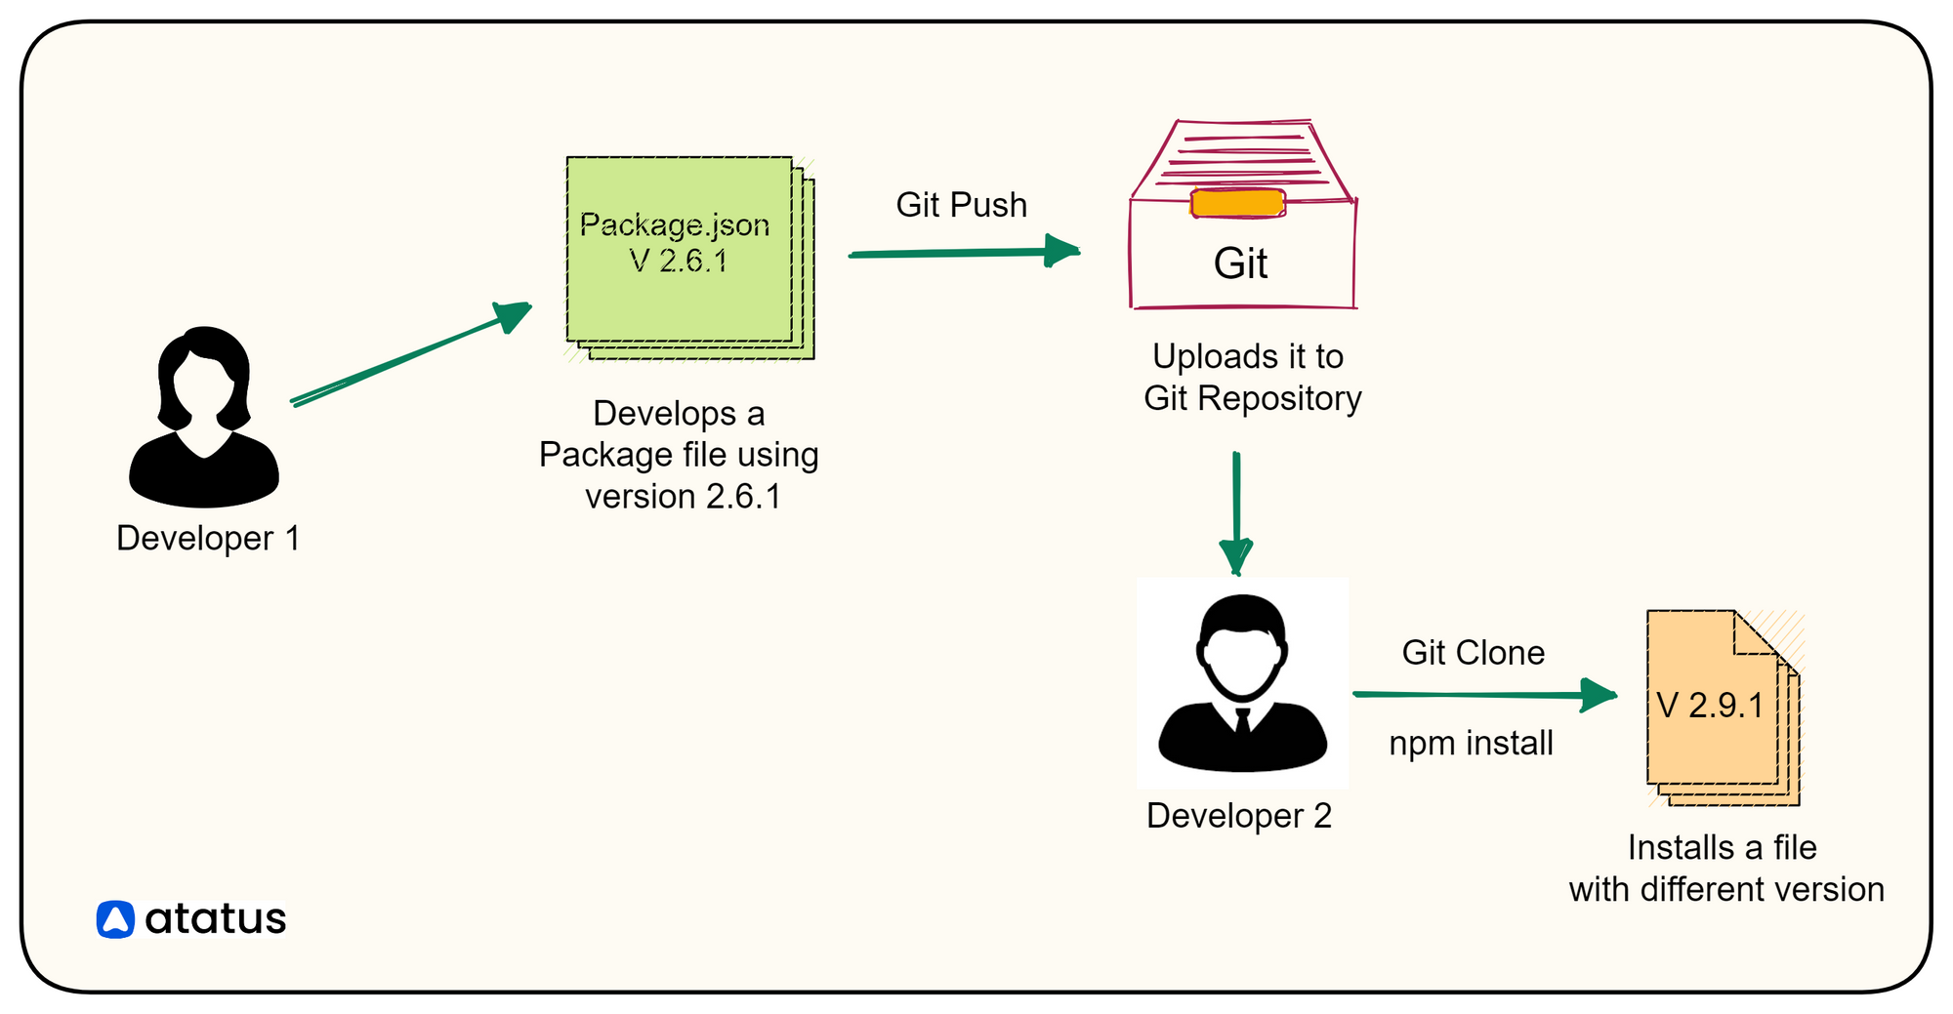
Package.json File
The package.json file is crucial for any Node.js project.
It contains metadata about the project, including its dependencies and scripts.
This file is created by running npm init and can be manually edited as needed.

Slide 6
Installing Packages
Packages can be installed using the command `npm install <package-name>`.
By default, this installs the package locally in the `node_modules` directory.
The `--global` option can be used to install packages globally on your system.

Slide 7
Versioning of Packages
npm uses semantic versioning (semver) to manage package versions.
Each version is represented as MAJOR.MINOR.PATCH, indicating changes made.
Developers can specify version ranges in `package.json` to control updates.

Slide 8
Updating Packages
Command Description
npm update Update All Packages To Latest Versions
npm outdated Check for Outdated Packages
npm update <package-name> Update a Specific Package
npm install <package-name>@latest This command installs the latest version of
a specific package
npm update –g Updates All Globally Installed Packages To Their
latest versions

Slide 9
Uninstalling Packages
To remove a package, use the command `npm uninstall <package-name>`.
This command removes the package from the `node_modules` directory and updates `package.json`.
You can also use the `--save` flag to ensure the dependency is removed from `package.json`.

Slide 10
npm Scripts
npm allows you to define custom scripts in the `package.json` file.
You can run scripts using `npm run <script-name>`.
Common scripts include `start`, `test`, and `build`, which streamline project workflows.

Slide 11
Lock Files
npm generates a `package-lock.json` file to ensure consistent installations.
This file records the exact version of each installed package and its dependencies.
Using lock files allows teams to maintain the same environment across different setups.

Slide 12
Security Audits
npm provides a built-in security audit feature to check for vulnerabilities.
Run `npm audit` to analyze the installed packages for known security issues.
Addressing vulnerabilities is crucial for maintaining secure applications.

Slide 13
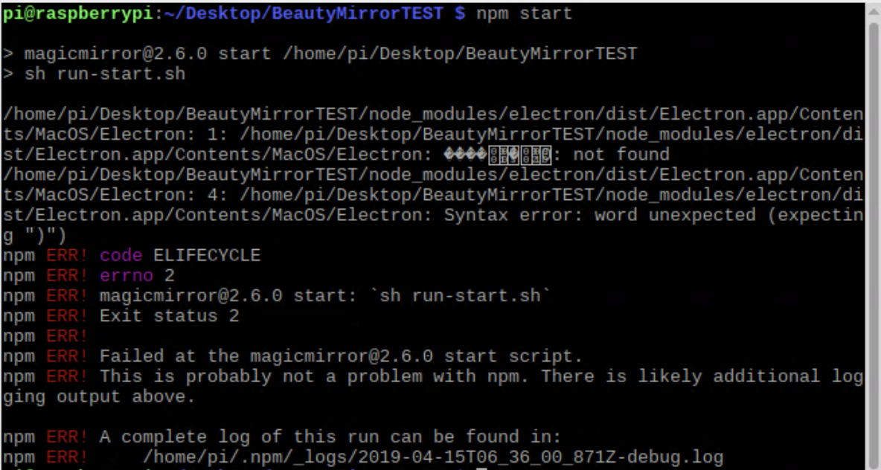
Troubleshooting npm Issues
Common issues include permission errors, cache problems, and outdated packages.
The npm documentation and community forums are valuable resources for solutions.
Running commands with the `--verbose` flag can help diagnose problems.

Slide 14


